Slide 1
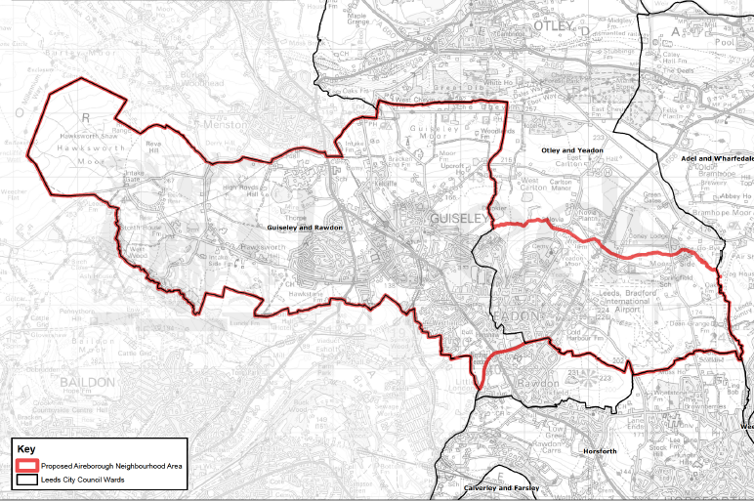
1. Hawksworth
Moor
5. Guiseley Moor
3 High Royds
Menston
6 Old Guiseley
2 Hawksworth
4 Tranmere, Park Rd,
Silverdale, Fieldhead
Back Lane
7 Nunroyd, Haw
& Queensway
9 Upper Yeadon
10 Yeadon Moor
8 Nether Yeadon, Henshaw,
Westfield
Green = Traditional Moors
Pinks = Traditional Settlements
Oranges = Infill estates

